Slide 1
COVID-19 DATA ANALYSIS AND FORECASTING
STUDENT DETAILS
REAHAAN SHERIFF I
2019202045
MCA-R 3yrs
Project guide
Ms.P.S.Apirajitha

Slide 2
MOTIVATION & OBJECTIVE
The spread of COVID-19 is increasing day by day, imposing human lives and economy at risk.
Due to the increased enormity of the number of COVID-19 cases, the role of Artificial Intelligence (AI) is imperative in the current scenario.
AI would be a powerful tool to fight against this pandemic outbreak by predicting the number of cases in advance.
The objective is to predict the cases and peak case date for COVID-19 in India as accurately as possible with LSTM model.

Slide 3
INTRODUCTION
Machine learning (ML) is a category of an algorithm that allows software applications to become more accurate in predicting outcomes without being explicitly programmed.
Long Short Term Memory is a kind of recurrent neural network.
LSTM can by default retain the information for a long period of time.
It is used for processing, predicting, and classifying on the basis of time-series data.

Slide 4
DATASET DETAILS
The trend of daily new cases.
Geospatial analysis of country-specific hotspots.
Comparison of top countries in vaccination race.
Share of people fully vaccinated.
Government policies during Covid-19.
Source - Datahub

Slide 5
IMPLEMENTATION PLATFORM
Google colab is used to implement this project.
LSTM machine learning model is used for prediction and forecasting.
Libraries used:
Pandas,
Numpy,
Seaborn,
Plotly,
Tensorflow

Slide 6
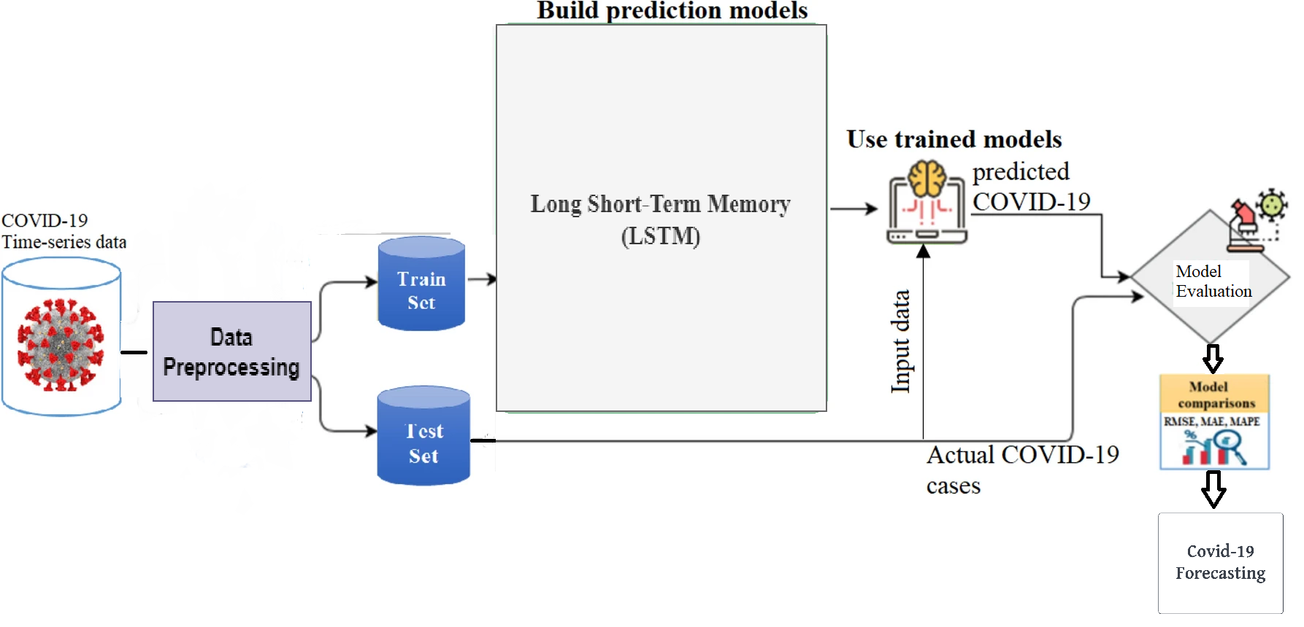
OVERALL ARCHITECTURE

Slide 7
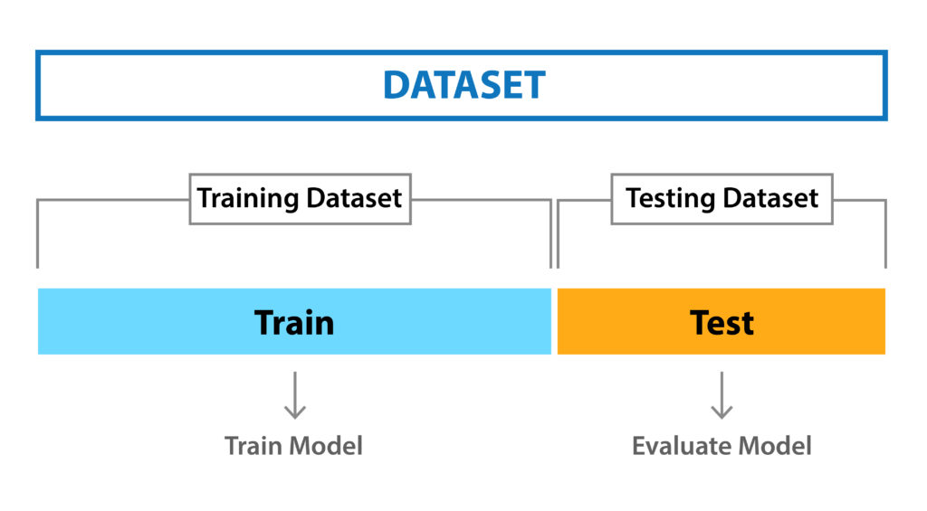
LIST OF MODULES
1. DATA PREPROCESSING
Data preprocessing is a process of preparing the raw data and making it suitable for a machine learning model. It is the first and crucial step while creating a machine learning model.

Slide 8
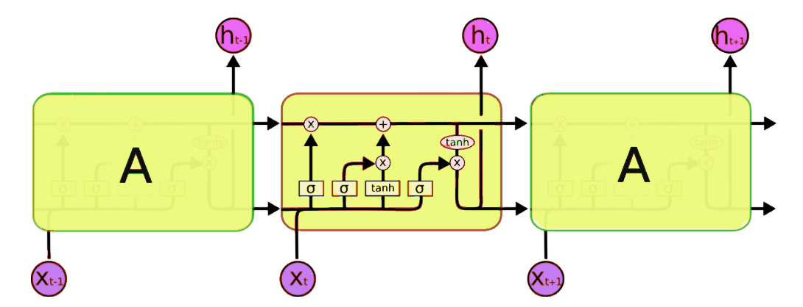
LIST OF MODULES
2. BUILDING MODEL
The LSTM model will learn a function that maps a sequence of past observations as input to an output observation

Slide 9
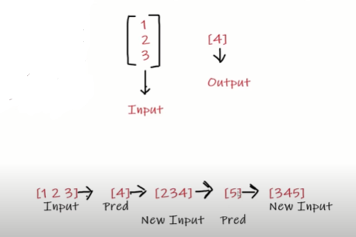
LIST OF MODULES
3. TRAINING MODEL
To train the model, we will take out training data (80%) and used 20% of it as validation data

Slide 10
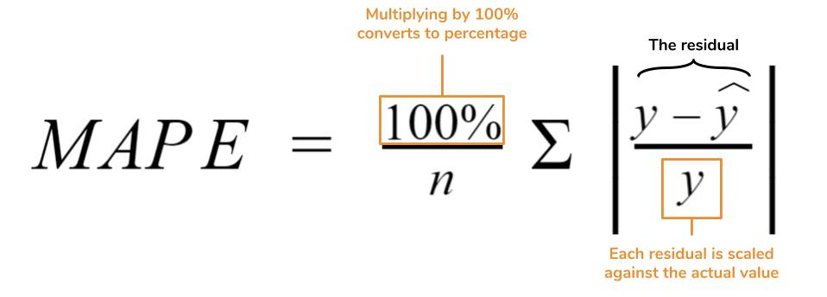
LIST OF MODULES
4. MODEL EVALUATION
It estimates how well (or how bad) the model is, in terms of its ability in mapping the relationship between X (a feature, or independent variable, or predictor variable) and Y (the target, or dependent variable, or response variable).

Slide 11

LIST OF MODULES
5. FORECASTING PREDICTION
LSTM model will be used on a time-series dataset to forecast the cases of COVID-19 in future.

Slide 12
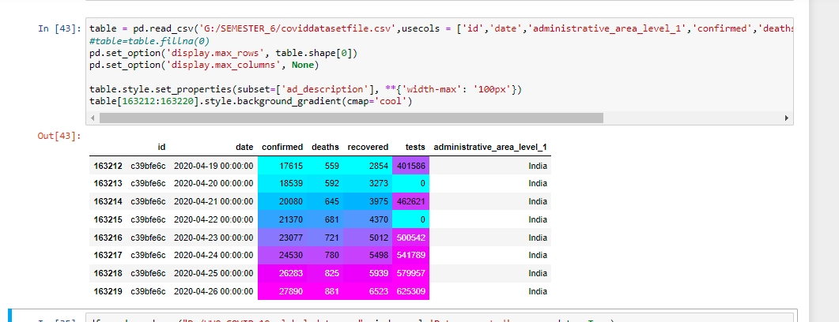
MODULE BASED OUTPUT SCREENSHOTS

Slide 13
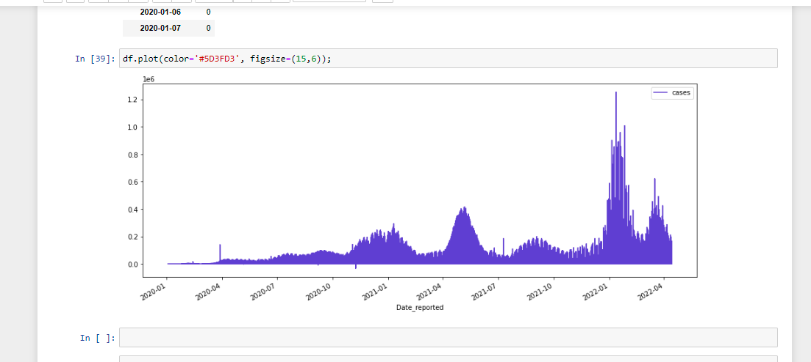
Analysis

Slide 14
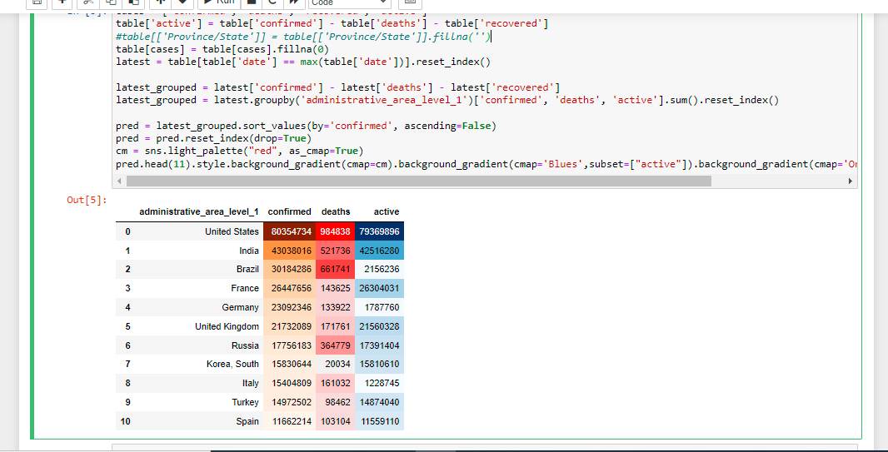
Analysis

Slide 15
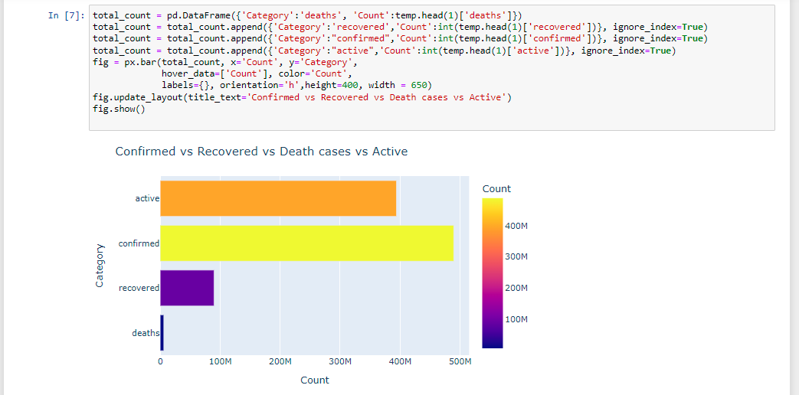
Analysis

Slide 16
REFERENCES
Wang J., Liu Y., Wei Y., Xia J., Yu T., Zhang X., Zhang L. Epidemiological and clinical characteristics of 99 cases of 2019 novel coronavirus pneumonia in Wuhan, China: a descriptive study. Lancet. 2020;395(10223):507–513.
JA Backer, D Klinkenberg and J. Wallinga, Incubation period of 2019 novel coronavirus (2019-nCoV) infections among travellers from Wuhan, China, 20–28 January 2020.
Tolga Ergen and Suleyman Serdar Kozat, "Efficient online learning algorithms based on LSTM neural networks", IEEE transactions on neural networks and learning systems, vol. 29, no. 8, pp. 3772-3783, 2017.

Slide 17
THANK YOU

